Slide 1
Bare Metal network isolation for cloud providers with OVN on DPUs
Mael Kimmerlin, Adrian Chiris, Tarek Abu-Hariri

Slide 2


Infrastructure Services Oriented Architecture
DPU - The Infra Services Execution Engine
TRADITIONAL SERVER
DPU-ACCELERATED SERVER
CPU
CPU
VMs
Containers
Infrastructure Services
Security Services
Storage Services
Networking Services
VMs
Containers
NIC
NVIDIA DPU with Arm Cores and Accelerators
Acceleration Engines
Infrastructure Services
Security Services
Storage Services
Networking Services
Acceleration Engines

Slide 3
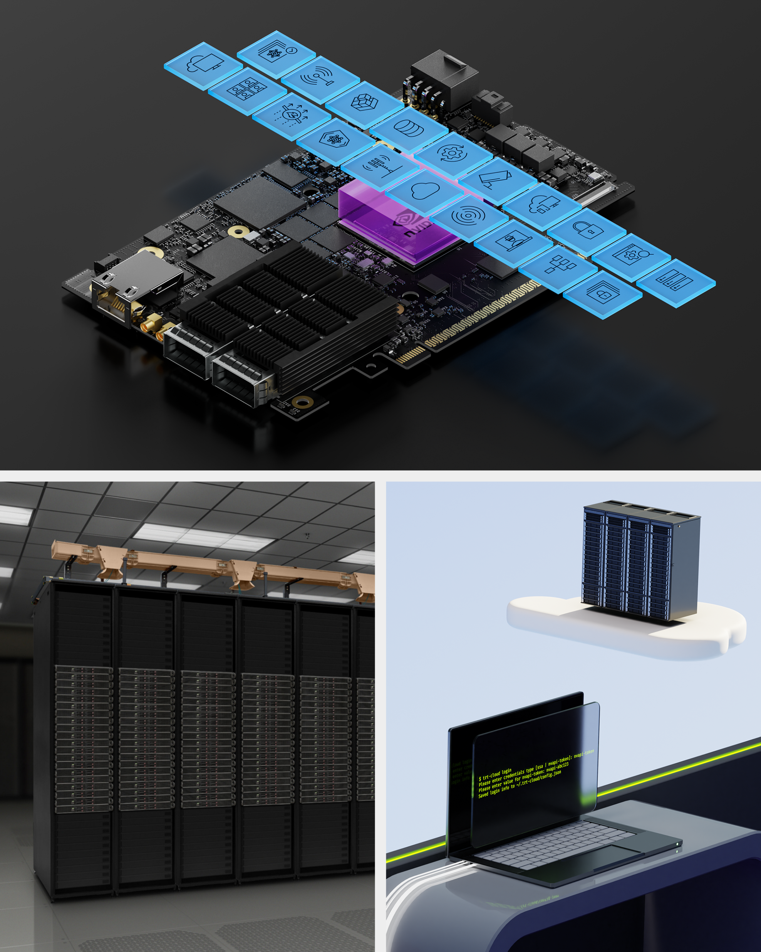
Bare Metal isolation with DPUs
Using OVN on Bluefield to isolate the host transparently
DPU is a separated trust domain
Based on OVN
OVN InterConnect (future)
BGP-EVPN integration (future)
ECMP via BGP (future)
Can be chained with other services
Router based on OVS (HBN)
firewall
Used to isolate host traffic at PF/VF level
Optimized for traffic bandwidth and limited hops
Logical structure like OVN-Kubernetes
API through CRDs (Kubernetes)
Network isolation per tenant, with overlay
No need for switch reconfiguration

Slide 4
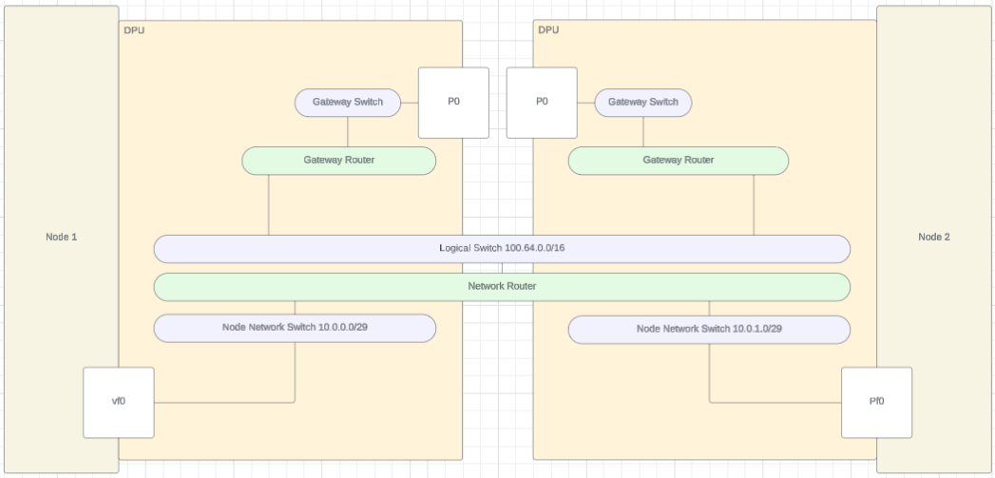
OVN VPC Service

Slide 5
Virtual topologies
L2 networks
Virtual Network (external)
DPUVirtualNetwork (external)
VPC
DPUVirtualNetwork
Virtual Network
Service Interface

Slide 6
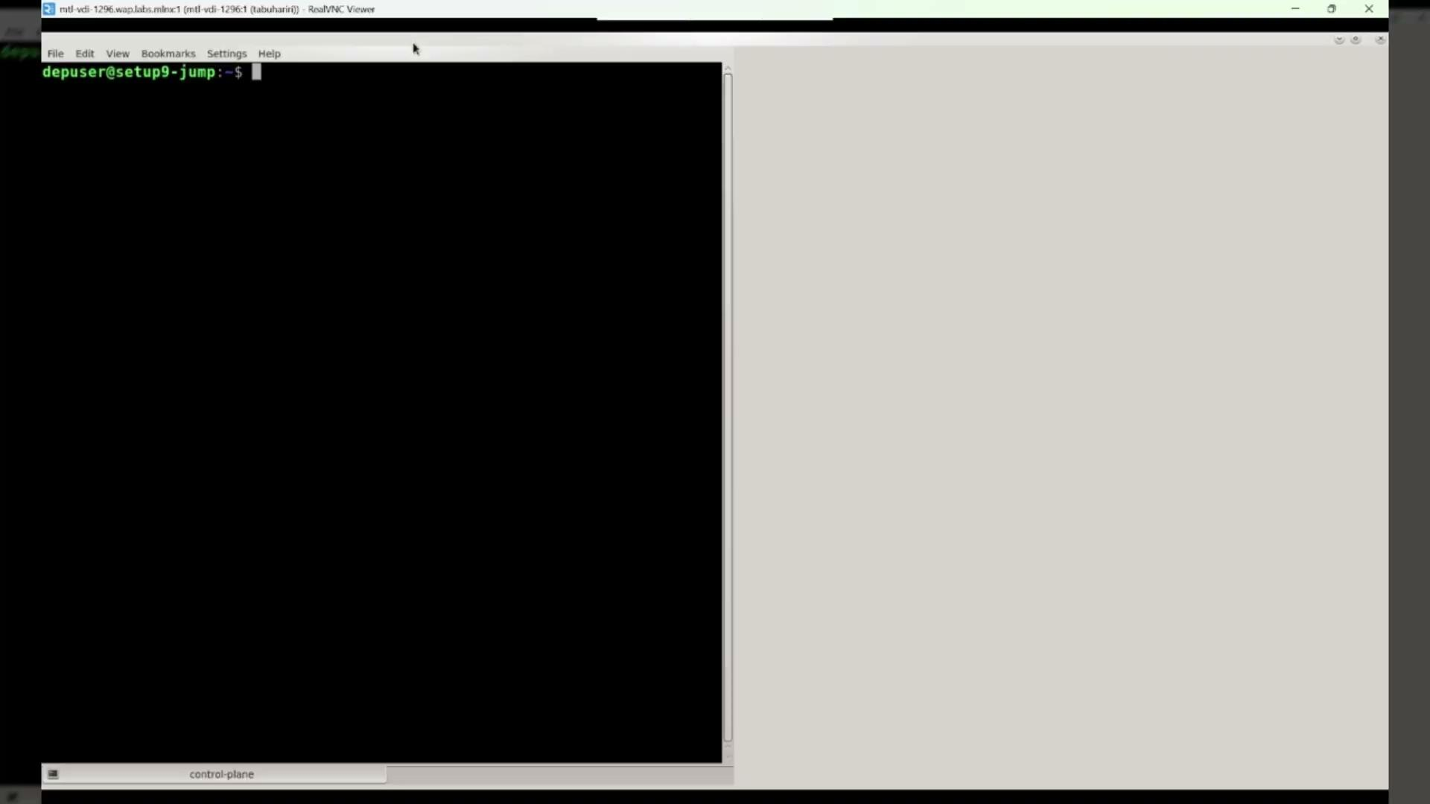
Demo
https://drive.google.com/file/d/1PldHxouFZXLKkLWTfIoEUEh_qoWCCqzP/view?usp=sharing

Slide 7
Test results
Alternative L2 topology
Node to node RoCE performance :
with Geneve encapsulation
on BF3, with 2*200Gb/s links
ECMP with additional OVS-based router (HBN)
2 DPUs with a single hop, a L3 ToR (BGP for ECMP)
Without ECMP : 191.9 Gb/s
With ECMP : 383 Gb/s

Slide 8
Custom Resources examples
VPC
apiVersion: vpc.dpu.nvidia.com/v1alpha1
kind: DPUVPC
metadata:
name: myvpc
namespace: default
spec:
tenant: foo
isolationClassName: ovn.vpc.dpu.nvidia.com
interNetworkAccess: true
nodeSelector: {}

Slide 9
Custom Resources examples
Virtual Network
apiVersion: vpc.dpu.nvidia.com/v1alpha1
kind: DPUVirtualNetwork
metadata:
name: pfnet
namespace: default
spec:
vpcName: myvpc
type: Bridged
externallyRouted: true
masquerade: true
bridgedNetwork:
ipam:
ipv4:
dhcp: true
subnet: 10.100.0.0/16

Slide 10
Custom Resources examples
Interface
apiVersion: svc.dpu.nvidia.com/v1alpha1
kind: DPUServiceInterface
metadata:
name: pf0
namespace: default
spec:
template:
spec:
interfaceType: pf
pf:
pfID: 0
virtualNetwork: pfnet

Slide 11
What’s next
OVN IC integration
Integration with offloaded CNI
BGP EVPN integration
Use OVN BGP instead of an external router
Integration of SFC through OVN
Providing an E-switch to the host (nested OVNs)
Strengthen multi-tenancy API (currently admin only)

